Slide 1
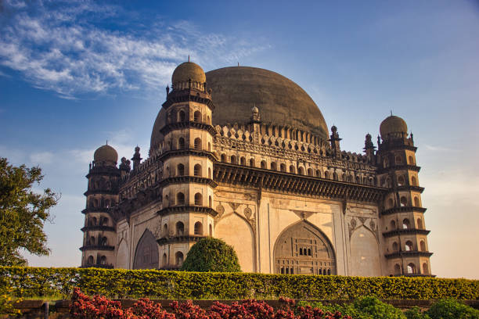
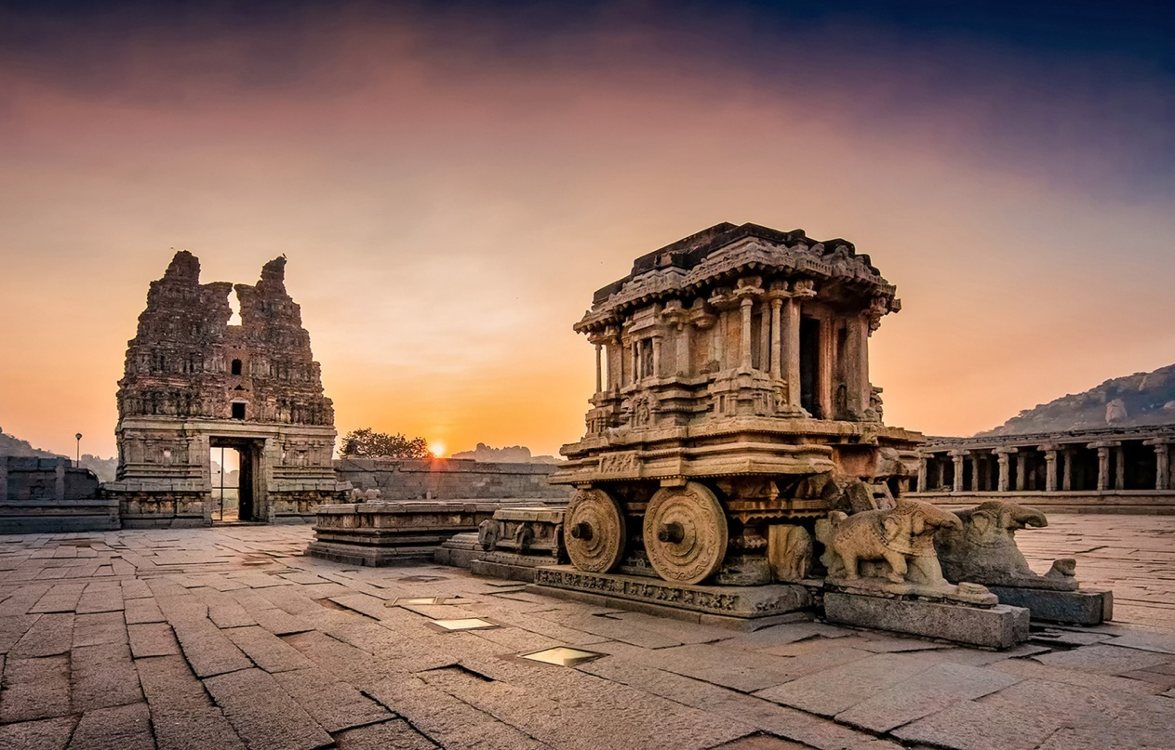

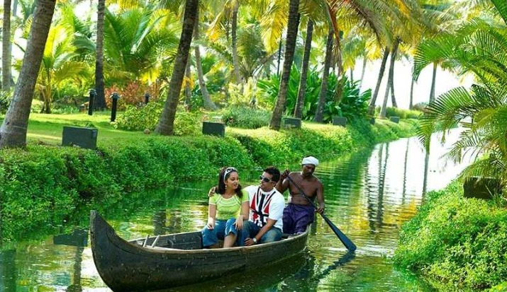
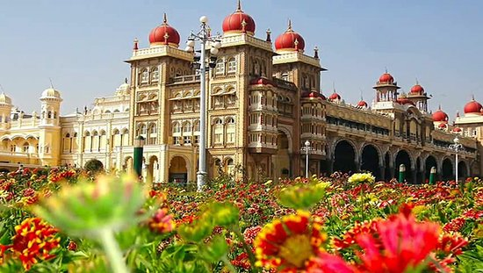

Slide 2
TOURISM MANAGEMENT SYSTEM
Under the Guidance of
Trainer Mrs. Indrakka Mali Presented by
Ms. Monika S.P
Ms. Nivetha S
Ms. Pavithra G
Ms. VishnuPriya D
Ms. Poonam Muttagikar

Slide 3
Content
Introduction
Objectives
Modules Description
Requirement
CRUD Operation
Annotation
Screenshots
Database Table Design
Conclusion

Slide 4
Introduction
The project “Tourism Management System” is developed using spring boot framework, which mainly focuses on basic operations of visitors information system.
In this project we have implemented admin module to maintain the visitor details and store all the information of the visitor on the database.
It will help visitors to find the perfect holiday place, accommodation with perfect price package.

Slide 5
Objectives :
It provides “better and efficient” service.
Faster way to get information about the admin visitors.
Provide facility for proper Accommodation and Package details.
All details will be available on a click.
System View :
The Tourism management system will be replacing the traditional system.
It reduces the paper work, checking visitor details is easy task here.
Adding, fetching, updating or deleting admin and customer field has become easy using certain methods.

Slide 6
Modules Description
Admin Module
In this class we have implemented the visitor details and created
the join column and combined the visitor class to view the visitor
details
In Admin class declared variables are admin name, email Id, price,
package, room type, destination and accommodation.
Details of the visitor and tourism package information will be stored
on the database and will be viewed using Postman to get the details of
visitor module.
Using GET method we can view all details of Visitors.

Slide 7
2. Visitor Module
In this module we have implemented the details of visitor.
In the visitor class the declared variables are visitor id, name, email id, mobile number and address.
Details of the visitor will be stored in the database and will be viewed using the HTTP client Postman.
Using GET method we can view all the details of visitor.

Slide 8
Requirement
Software Requirement
Operating System : Windows 10
Database: MySQL .
API- Spring Data JPA, spring web, spring security.
Tools: Postman, IDE-Spring Tool Suit4 .
Coding language: Java 8.

Slide 9
Hardware Requirement
RAM : 8GB
Processor : Intel core i3
Memory : 700MB
Disk Space : 1TB

Slide 10
CRUD Operations
CRUD stands for Create, Read/Retrieve, Update and Delete, these are four basic operations that we have performed on persistence storage. It is data oriented and the standardized use of HTTP methods.
Standard CRUD Operations are as follows:
POST : Creating a new resource
GET : Read/Retrieve a resource
PUT : Update an existing resource
DELETE : Delete an existing resource
As name suggests,
CREATE Operation: It perform insert statement to create a new record.
READ Operation: It reads table records based on the input parameter.
UPDATE Operation: It executes an update statement on the table based on input parameter.
DELETE Operation: It deletes a specified row in the table based on input parameter

Slide 11
Annotation
1. @Entity : It specifies that the class is an entity and is mapped to a database table.
2. @Table : It specifies the name of the database table to be use for mapping.
3. @Id : It specific variable primary key of the database.
4. @NotNull : Content is not null on the table.
5. @NotBlank : Used to context is not empty on the table.
6. @Length : Used to specify the length of content placed on the table.
7. @Service : We mark beans with @Service to indicate that they're holding the business logic.

Slide 12
8.@Repository : It is used to access the database directly.
9.@Autowired : The spring framework enables automatic dependency injection.
10.@RestController : It is used at the class level and allows the class to handle the requests made by the client.
11.@GetMapping : Is a specialized version of @RequestMapping annotation that acts as a shortcut for @RequestMapping(method = RequestMethod.GET).
12.@PostMapping : The methods in the @Controller annotated classes handle the HTTP POST requests matched with given URI expression.
13.@DeleteMapping : It maps the HTTP DELETE requests on the specific handler method.

Slide 13
13.@PutMapping: It maps the HTTP PUT requests on the specific handler method. 14.@GeneratedValue : Marking a field with the annotation specifies that a value will be automatically generated for the field. 15.@SequenceGenerator : The defines a primary key generator that may be referenced by name when a generator element is specified for the Generated Value annotation. 16. @JoinColumn : Used to combine the foreign key column on this table. 17.@OneToMany : A one-to-many relationship between two entities is defined by using the @OneToMany annotation in Spring Data JPA.

Slide 14
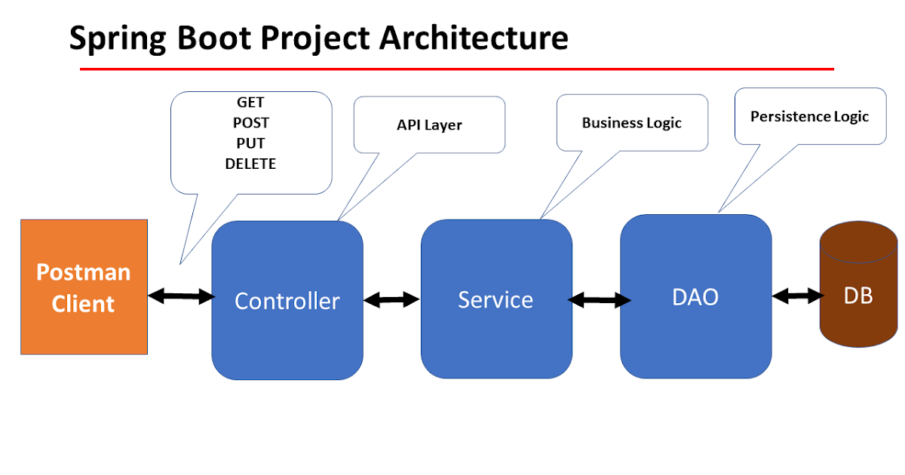

Slide 15
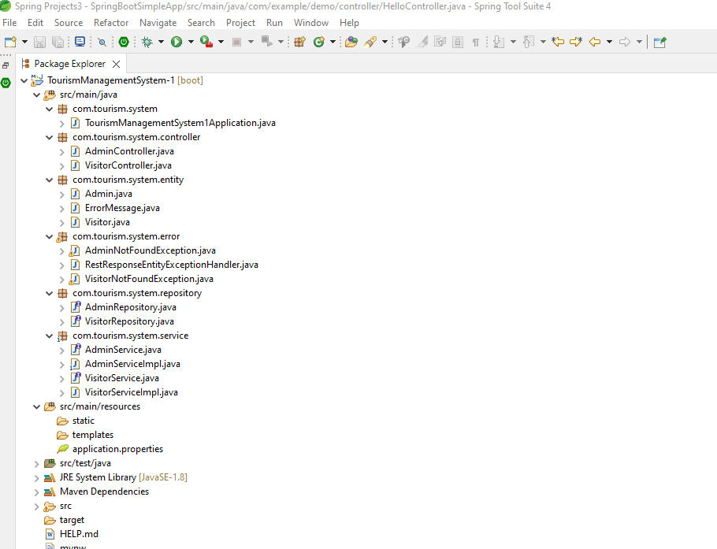
Structure of the project

Slide 16
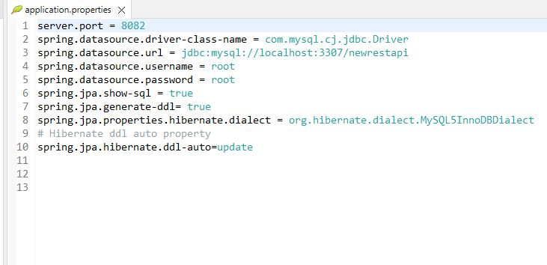
Database Connection

Slide 17
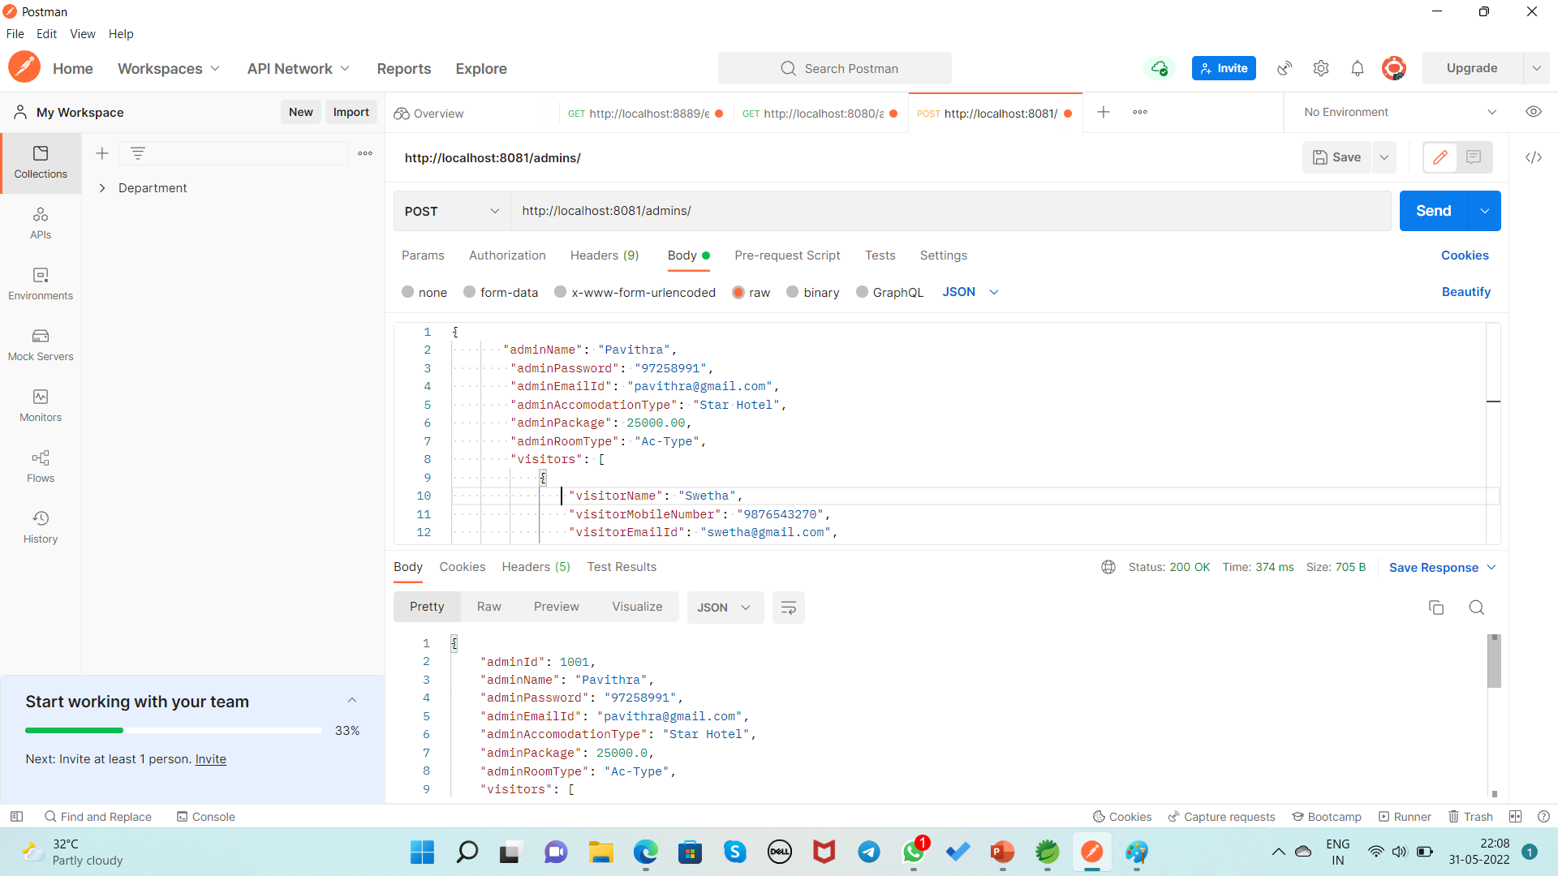
Screenshot Inserting the Admin and Visitor By Using POST Method URL:http://localhost:8081/admins/

Slide 18
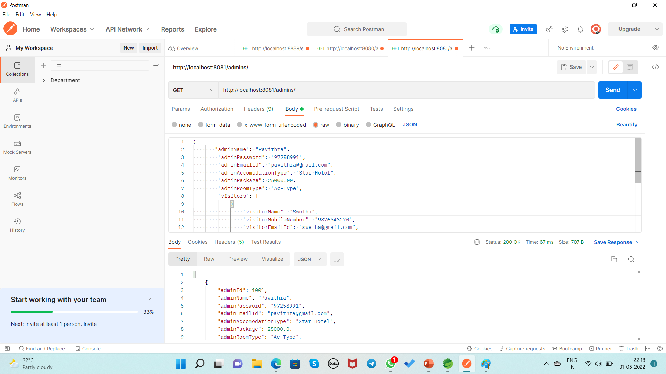
Display the all record of Admin By Using GET Method URL:http://localhost:8081/admins/

Slide 19
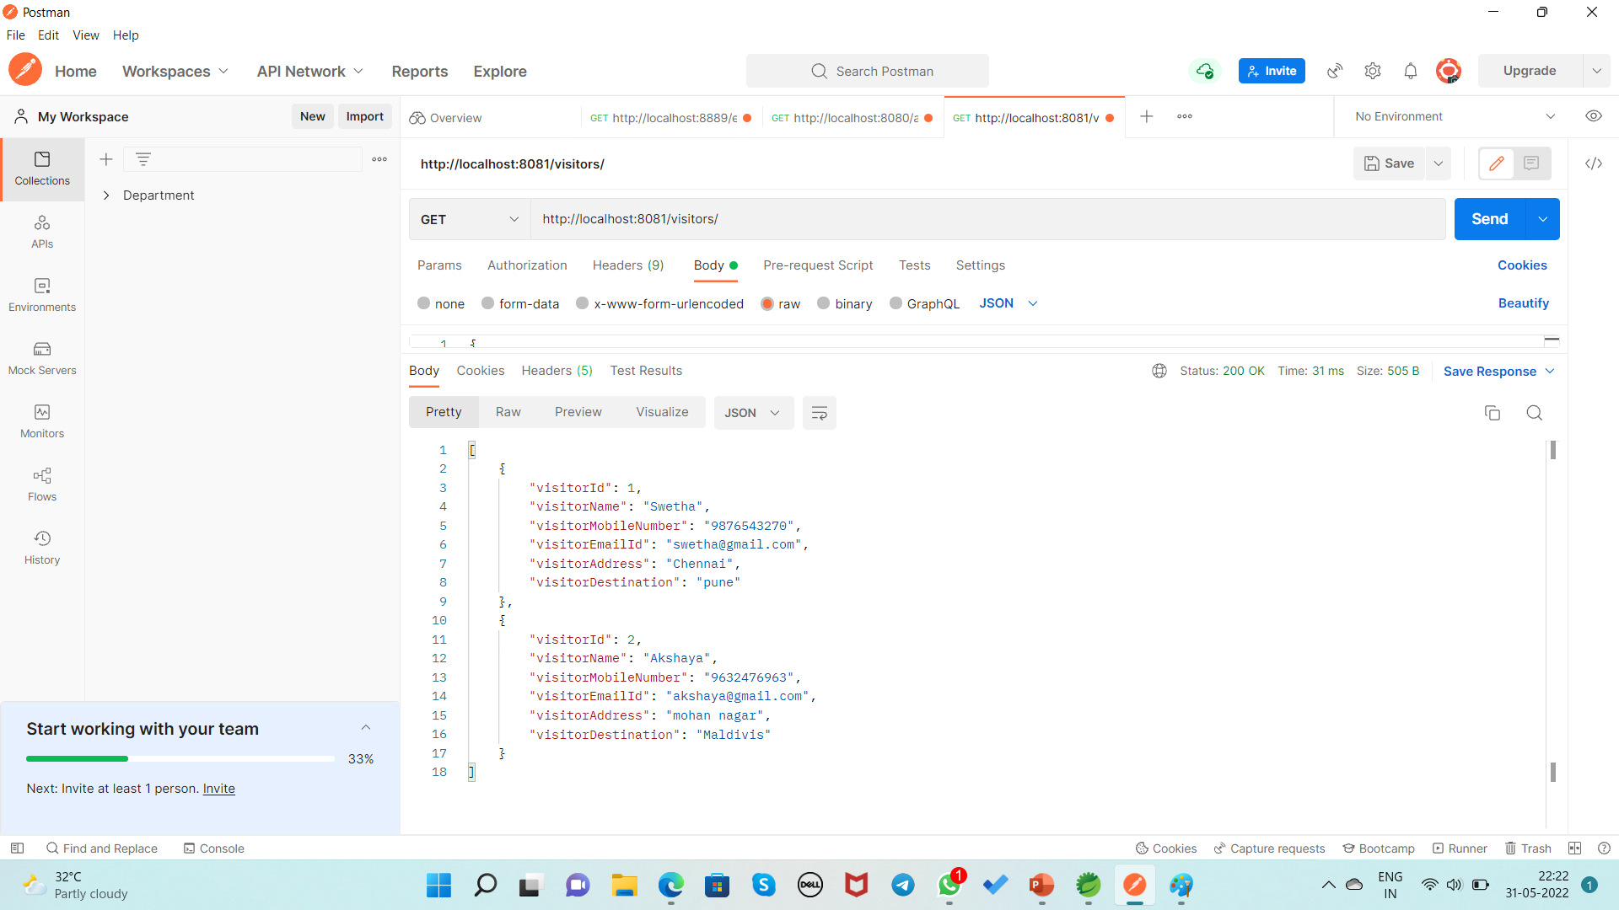
Display the all record of Visitor By Using GET Method URL:http://localhost:8081/visitors/

Slide 20
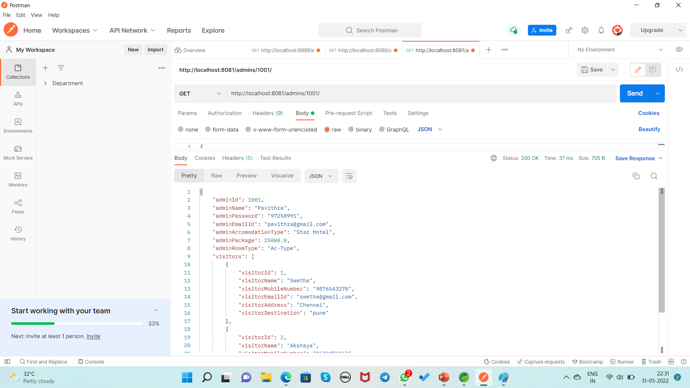
Display the record of Admin based on Id By Using GET Method URL:http://localhost:8081/admins/1001/

Slide 21
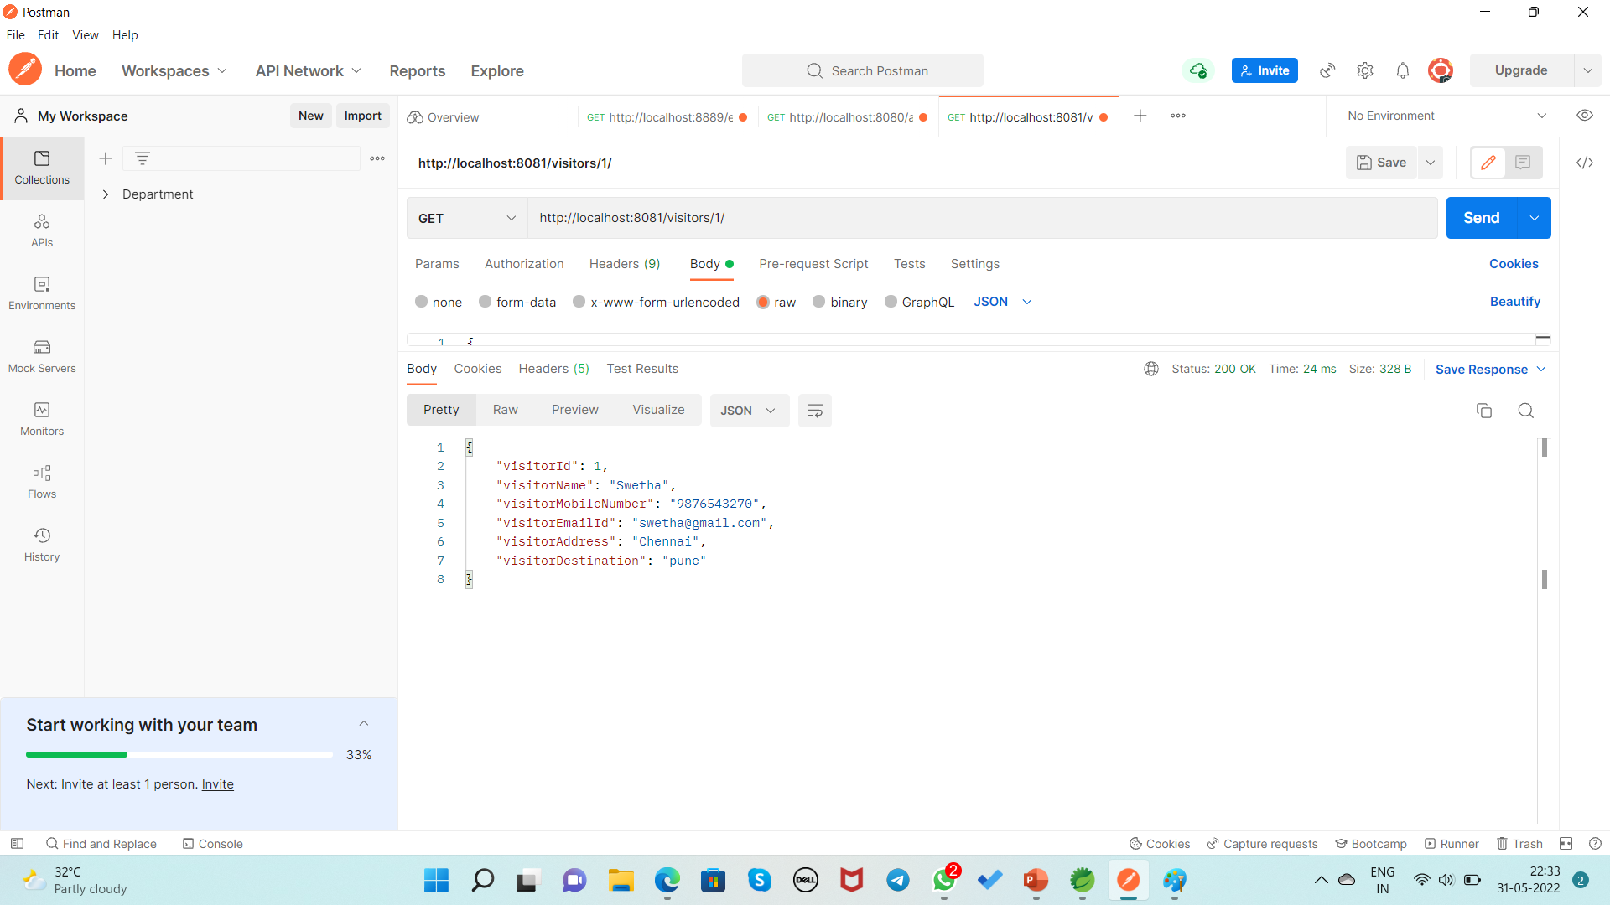
Display the record of Visitor based on Id By Using GET Method URL:http://localhost:8081/visitors/1/

Slide 22
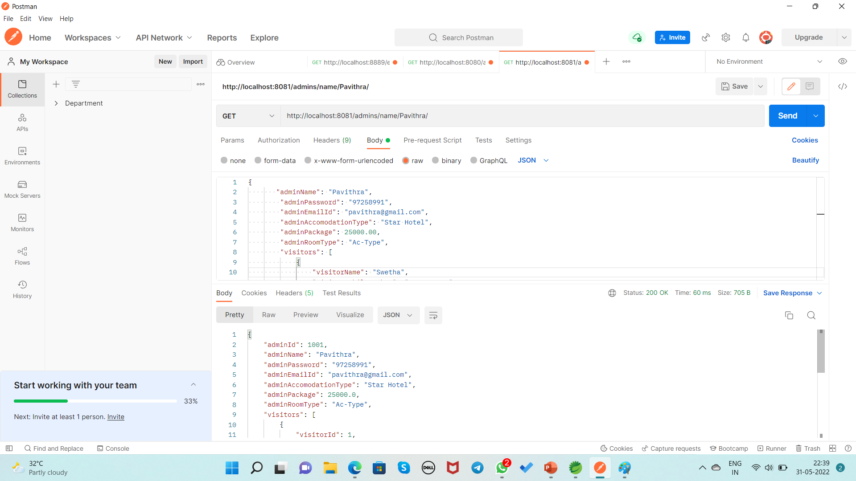
Display the record of Admin based on Name By Using GET Method URL:http://localhost:8081/admins/name/Pavithra/

Slide 23
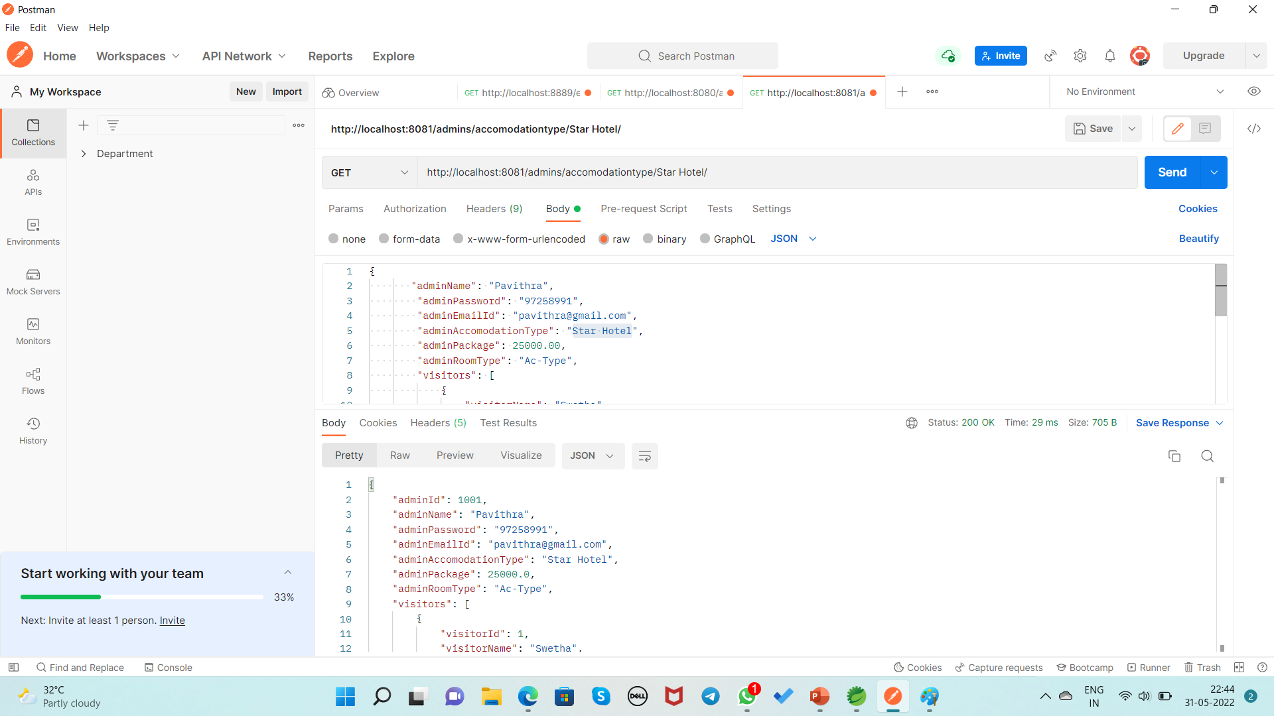
Display the record of Admin based on AccomodationType By Using GET Method URL:http://localhost:8081/admins/accomodationtype/Star Hotel/

Slide 24

Display the record of Admin based on RoomType By Using GET Method URL:http://localhost:8081/admins/room type/Ac-Type/

Slide 25
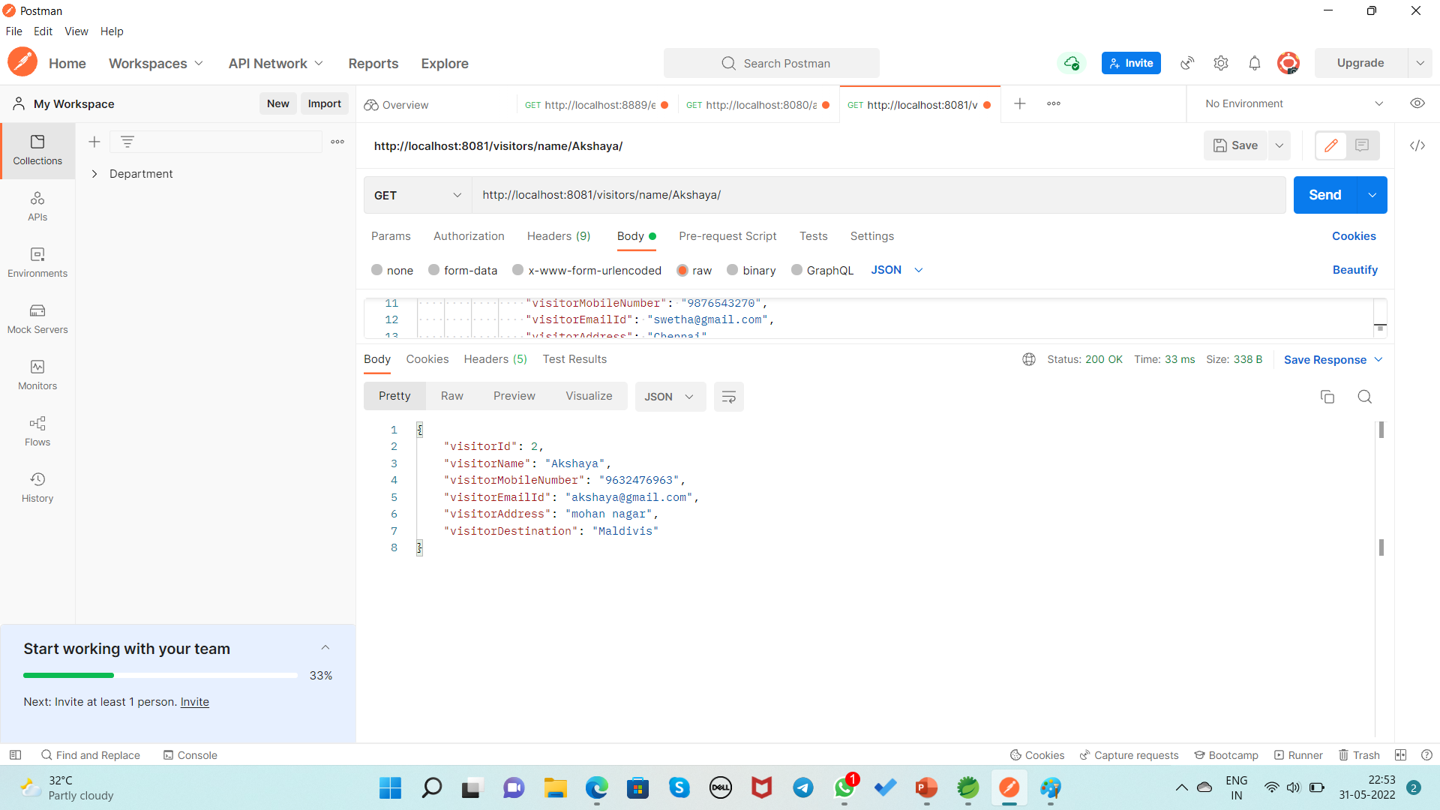
Display the record of Visitor based on Name By Using GET Method URL:http://localhost:8081/visitors/name/Akshaya/

Slide 26
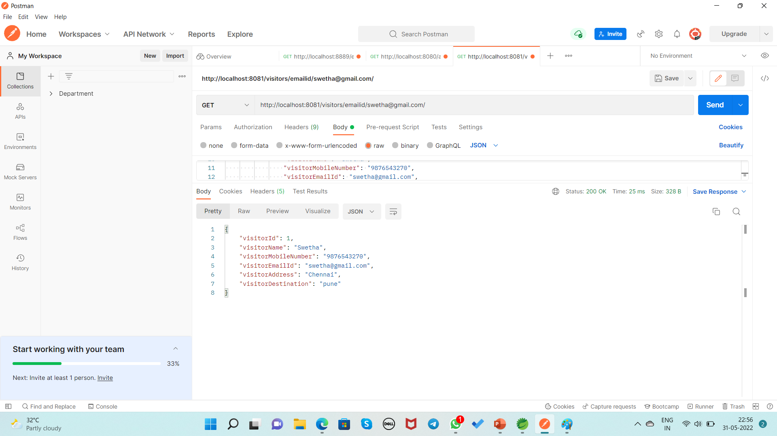
Display the record of Visitor based on EmailId By Using GET Method URL:http://localhost:8081/visitors/emailid/swetha@gmail.com/

Slide 27
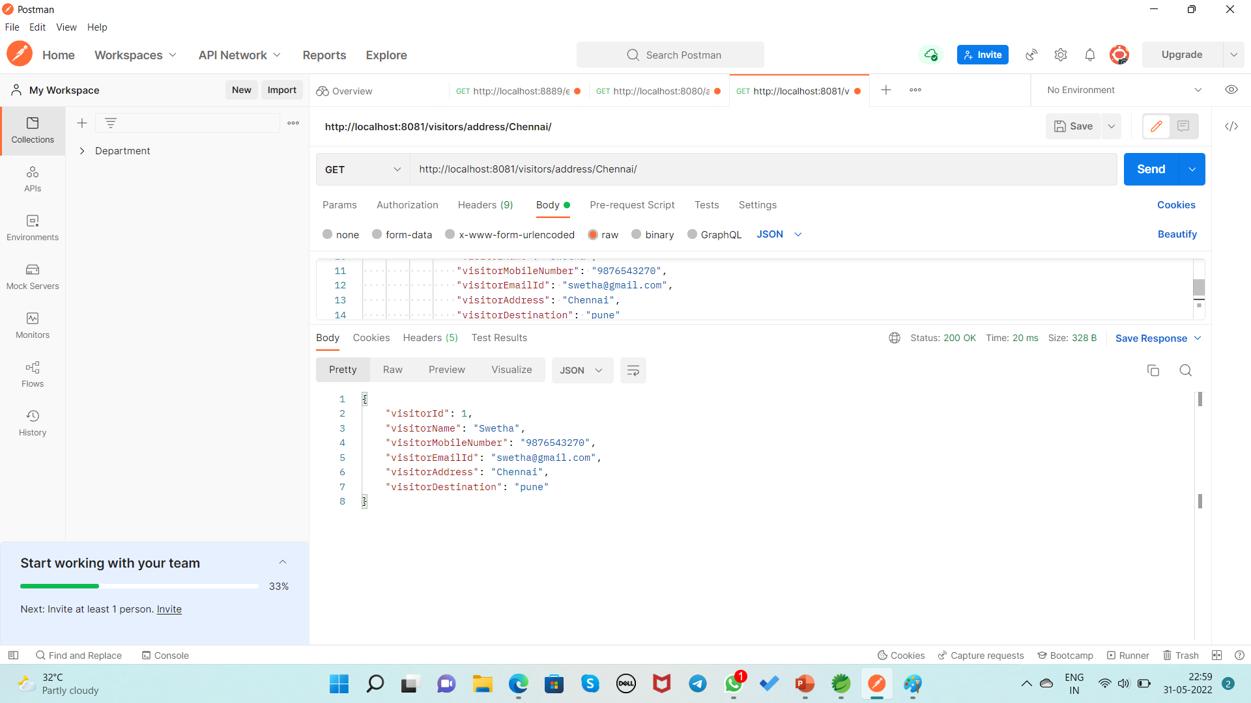
Display the record of Visitor based on Address By Using GET Method URL:http://localhost:8081/visitors/address/Chennai/

Slide 28
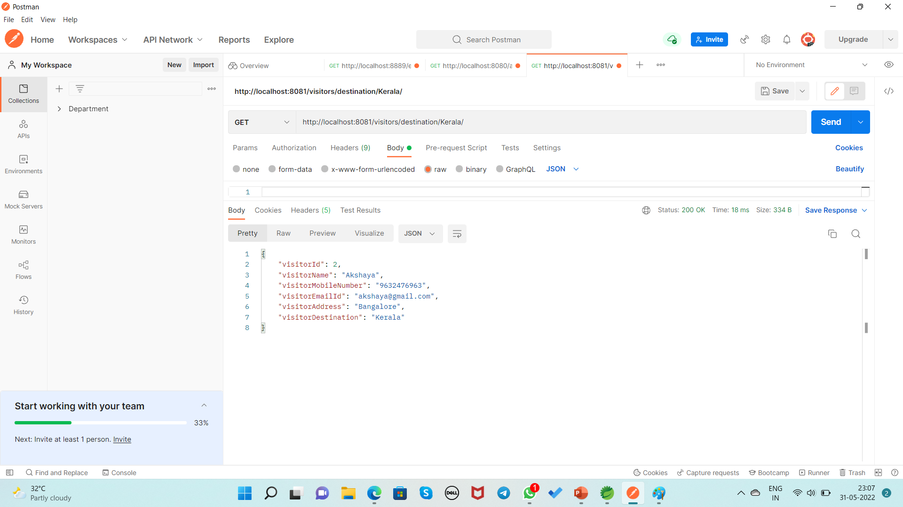
Display the record of Visitor based on Destination By Using GET Method URL:http://localhost:8081/visitors/destination/Kerala/

Slide 29
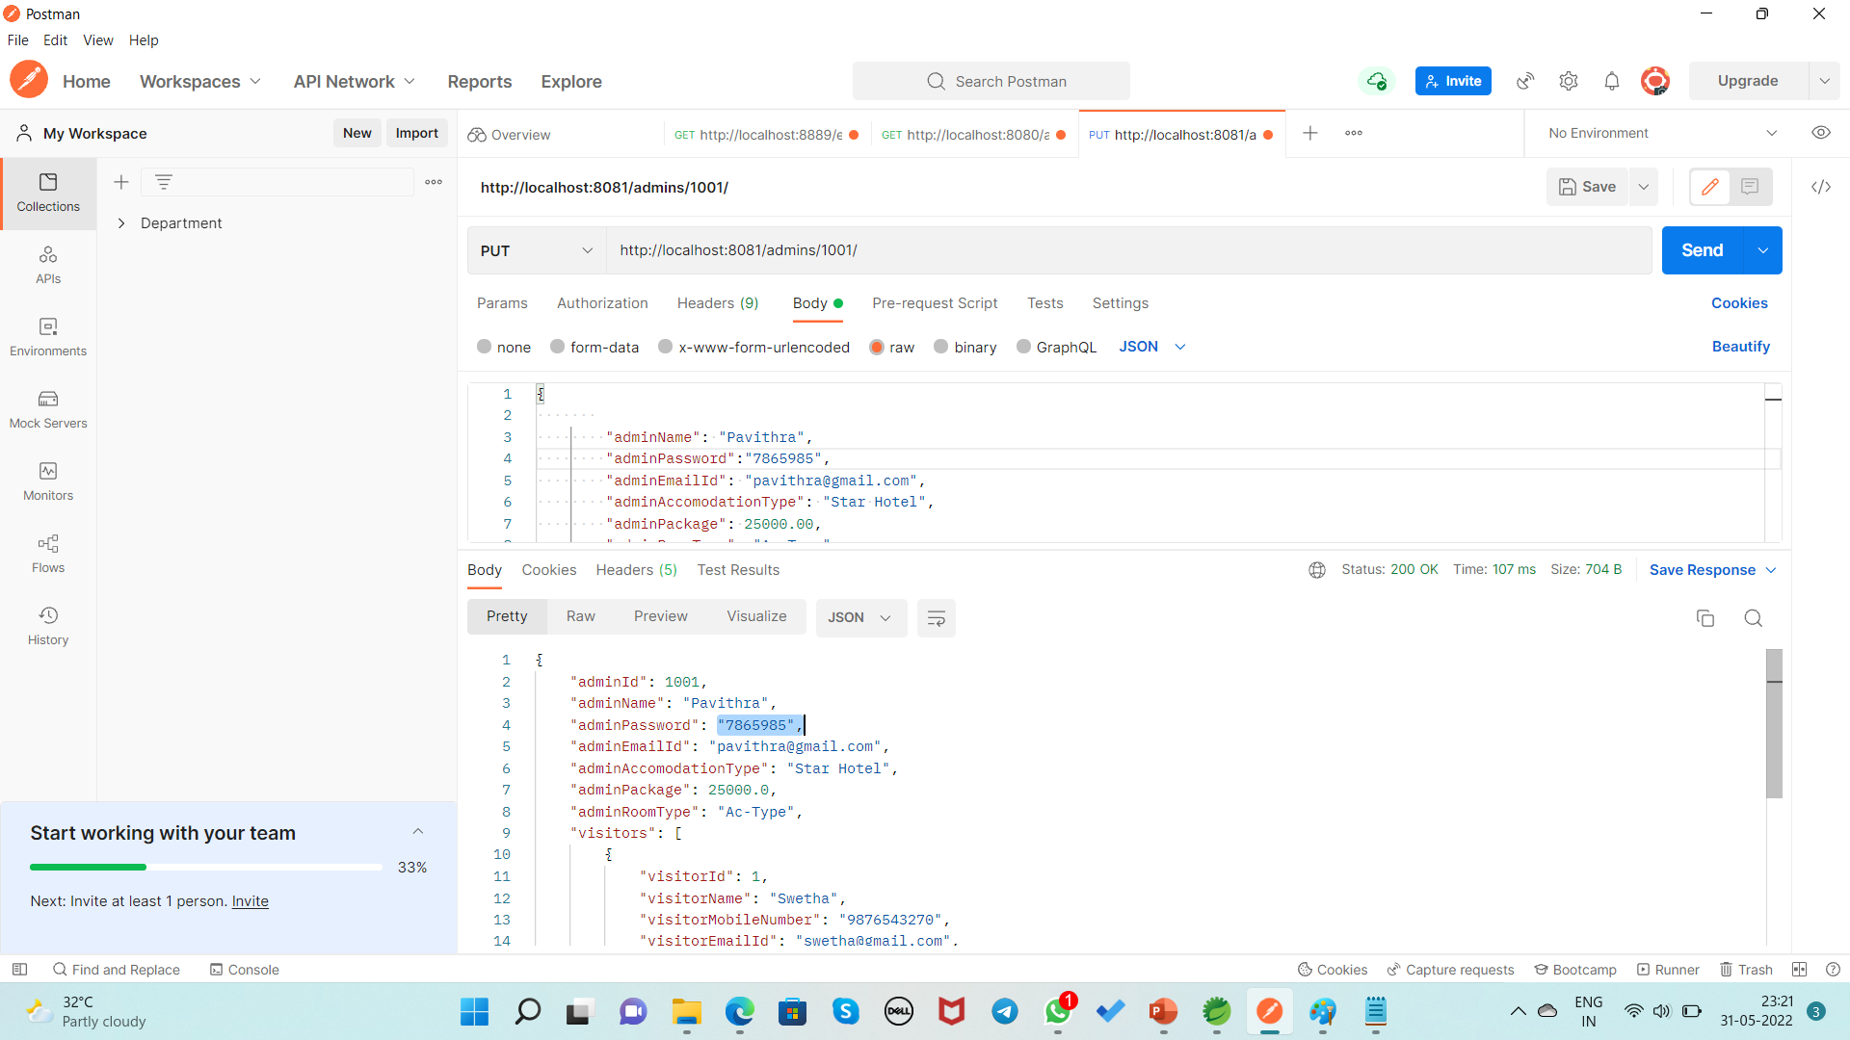
If Admin wants to change the Password By Using PUT Method URL:http://localhost:8081/admins/1001/

Slide 30
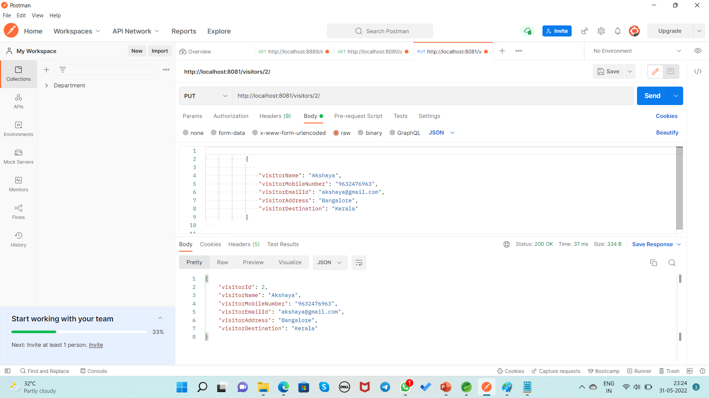
If Visitor wants to change the Address and Destination By Using PUT Method URL:http://localhost:8081/visitors/2/

Slide 31
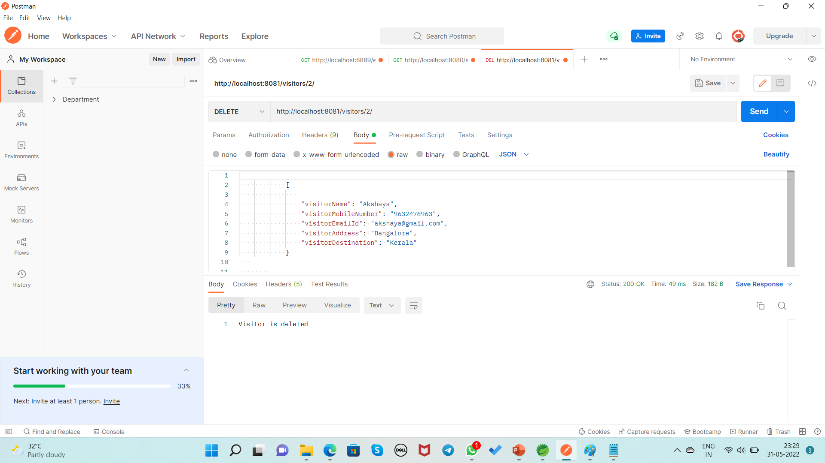
Deleting the Visitor Record Based on Id By Using DELETE Method URL:http://localhost:8081/visitors/2/

Slide 32
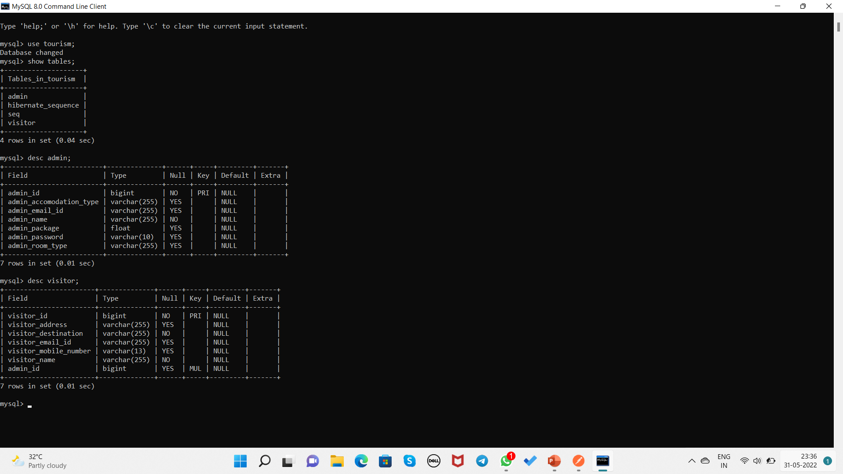
Database Table Design

Slide 33
Conclusion
India is one of the most beautiful location of South Asia is also among the popular countries of the world. The trip to the different parts of this country can reveal numerous mystic things regarding its culture, art, tradition and history.
Tourism Management System makes visitors easy to choose tourist place and accommodation through affordable packages, It has become easy for tourist to find perfect place for them. It is concluded that the application works well and satisfy the need.

Slide 34
THANK YOU…

